Slide 1
Bioimage Informatics
Project 4: Image Segmentation
Vineet Joshi, Frank Lin, Prateek Tandon

Slide 2
Overview
Part 1: Image segmentation techniques implemented in ITK are tested
Confidence Connected Segmentation (SCC)
Shape Detection Level Set Filter (SSDLS)
Part 2: Graph-cut and active-contour image segmentation algorithms tested
Normalized Cut
Efficient Graph-based Segmentation
Distance Regularized Level Set Evolution (DRLSE)
Gradient Vector Flow

Slide 3
B.1
The MAT-ITK package downloaded and installed
Images downloaded
‘60x_02.tif’
‘Blue0001.tif’
‘Mito_GFP_a01’

Slide 4
Confidence Connected Segmentation (SCC)

Slide 5
B.2.1 (SCC)
Required Inputs
Parameters
Multiplier
Number of Iterations
Replace Values
Image
Seed
Parameters tested by iterating over different values
Started with suggested default values (2.5, 5, 100)
Replace values didn’t have a big impact
Ideal = (4, 5, 1)

Slide 6
B.2.1 (SCC)
How to get Seed Points
Tested different seed points on both images
Middle seed point worked for both images
[rows cols numberOfColorChannels] = size(Img);
x1 = cols/2;
y1 = rows/2;
z1 = 1;
seeds = [x1 y1 z1];

Slide 7
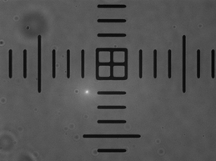
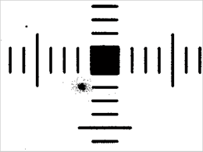
B.2.1 (SCC)
‘60x_02.tif’

Slide 8
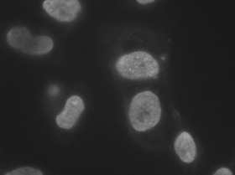
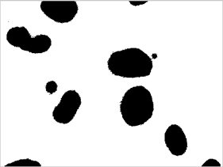
B.2.1 (SCC)
‘Blue0001.tif’

Slide 9
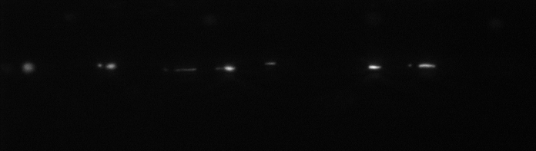
B.2.2 (SCC)
Parameters = (10, 5, 1)
Seed Point = (40, 90, 1)

Slide 10

B.2.2 (SCC)

Slide 11
B.2.3 (SCC) Theory
The confidence connected segmentation method is based on a region growing technique
First, the user places a seed point
The algorithm extracts a set of pixels that are connected based on pixel intensities statistically consistent with a seed point.
The algorithm then computes the initial mean and standard deviation around that pixel.

Slide 12
B.2.3 (SCC)
Then only the neighboring pixels whose values lie within a confidence interval for this seed are grouped together.
Confidence interval is defined as Mean ± Multiplier*S.D.
I(x,y)∈(μ- M∗σ, μ+ M∗σ)
The Multiplier (M) controls the confidence interval’s width and hence size of the grouping.

Slide 13
B.2.3 (SCC)
Smaller M will result in smaller C.I. which may restrict the inclusion of pixels with slightly different intensities lying in the same segment.
A large M will result in a large CI which may result in the inclusion of pixels that are part of different segments.
The mean and variance (S.D.) are then re-calculated, this time using the pixels from the grouping in the previous segmentation.
The entire process is repeated for a fixed number of iterations that are controlled by the user.

Slide 14
B.2.3 (SCC)
An image with low homogeneity requires a higher number of iterations while image with higher homogeneity requires lesser iterations.
We must remove noise in the image using a filter as it interferes with the quality of segmentation process.

Slide 15
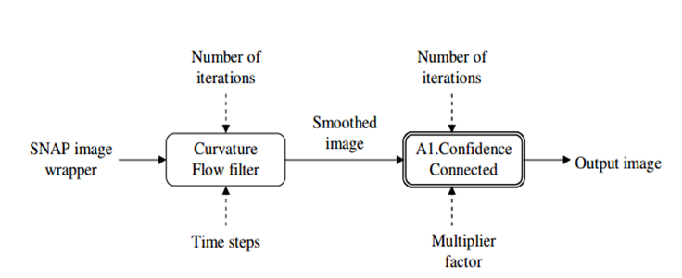
B.2.3 (SCC)

Slide 16
Shape Detection Level Set Filter (SSDLS)

Slide 17
B.2.1 (SSDLS)
Required Inputs
Parameters
Propagation Scaling
Curvature Scaling
Set Maximum RMS error
Number of iterations
Image
Gradient of Image
Parameters tested by iterating over different values
Parameters made no noticeable differences, Gradient values made the biggest difference
Ideal = (1,1,0.02,1)

Slide 18
B.2.1 (SSDLS)
Gradient Calculations
Used built in MATLAB function gradient()
D = image converted for MATITK
gradient (D) only gave x gradient
[gradx,grady] = gradient(D);
DG = gradx + grady;

Slide 19
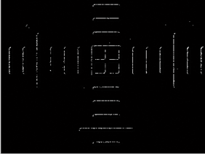
B.2.1 (SSDLS)
‘60x_02.tif’

Slide 20
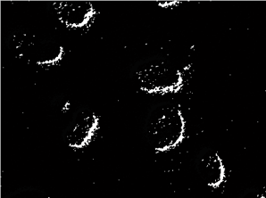
B.2.1 (SSDLS)
‘Blue0001.tif’

Slide 21
B.2.2 (SSDLS)
Parameters = (1, 1, 0.02, 1)
Parameters did not have a big impact
Gradient calculated the same way as 2.1
[gradx,grady] = gradient(D);
DG = gradx + grady;

Slide 22

B.2.2 (SSDLS)

Slide 23

B.2.3 (SSDLS) Theory
Uses a level set method segmentation filter that employs a level set function.
The level set method (LSM) is a numerical technique for tracking interfaces and shapes on a fixed Cartesian grid.
The boundary of the shape is then the zero level set of the function, while the shape itself is the set of points in the plane for which it is positive

Slide 24
B.2.3 (SSDLS)
An initial contour is propagated outwards or inwards until it ''sticks'' to the shape boundaries.
The filter takes in two inputs, an ‘initial level set’ and ‘feature image’.
The initial level set consists of a real image
The feature image consists of an edge potential map or edge features of the image. This is equivalent to the level set function

Slide 25
B.2.3 (SSDLS)
The edge potential is derived from the image gradient of the real image using the formula,
g(I)=1/(1+|(∇∗G)(I)| )
Here I is image intensity and (∇∗G) is the derivative of Gaussian operator.
This is known as the Shape Detection Level Set Function and it is a subclass of the generic Level Set Function.
It has values close to zero in regions near the edges (high image gradient) and values close to one the inside the shapes

Slide 26
B.2.3 (SSDLS)
Parameter tuning is important
Propagation Scaling and Curvature Scaling parameters can be can be used to adjust the smoothness of the resulting contour.
Curvature Scaling parameter should be assigned a positive value for proper function of the algorithm.

Slide 27
B.2.3 (SSDLS)
The algorithm outputs a single, scalar, real-valued image.
The insides of the segmentation regions are represented by negative values in the output image and outsides of the segmentation regions are represented by positive values.
The zero crossovers in the output image correspond to the position of the propagation front.

Slide 28


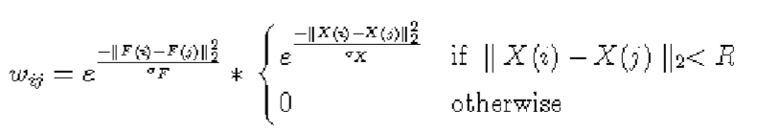
C.1.1 (Normalized Cut)
Based on minimum cut and bipartite matching in graphs
Ncut:
Ncut minimized solving the eigenvalue system
W – affinity/similarity matrix
W_{ij}:

Slide 29
C.1.1 (Normalized Cut)
X(i) – node location, F(i) – intensity vector of node i
Steps:
Construct weighted graph G = (V,E) from image
Solve Eigen value system for eigenvector with 2nd smallest eigenvalue
Check cut’s stability and evaluate its necessity to be subdivided
Recurse over till all partitions of G are segmented

Slide 30
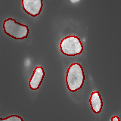
C.1.1 (Normalized Cut)
number of segments = 8, sampleRadius = 10, sample_rate = 6.0, edgeVariance = 0.05

Slide 31
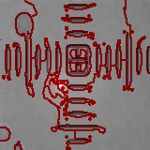
C.1.1 (Normalized Cut)
number of segments = 25, sampleRadius = 15, sample_rate = 9.0, edgeVariance = 0.017

Slide 32
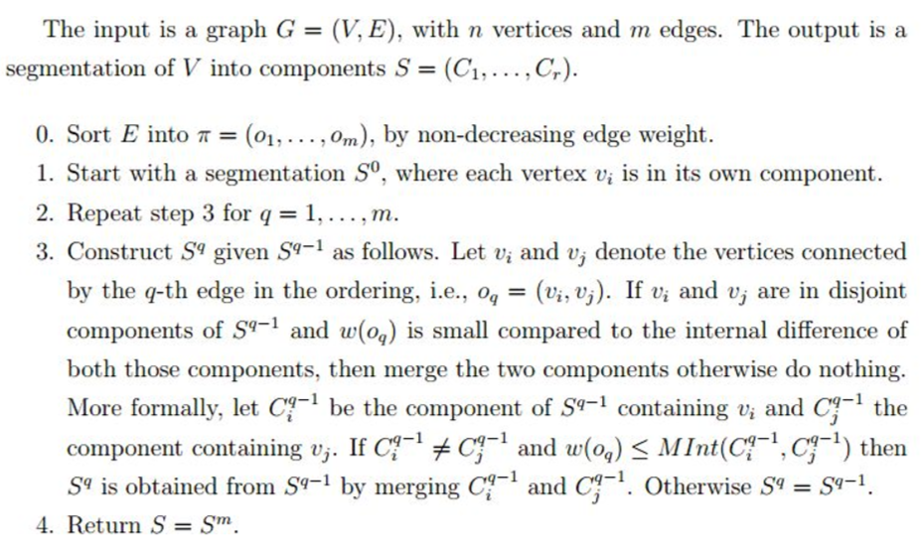
C.1.1 (Efficient Graph Based)

Slide 33

C.1.1 (Efficient Graph Based)
sigma = 0.9, K = 450, min = 100

Slide 34

C.1.1 (Efficient Graph Based)
sigma = 1.2, K = 1300, min = 100

Slide 35

C.1.2 (DRLSE)
Distance Regularized Level Set Evolution
For capturing dynamic interfaces and shapes
Contour -> 0-level set of higher dim. function called LSF
Contour motion ~ evolution of LSF
C(s,t) : [0,1]x[0,∞) -> R² dynamic parametric contour
Curve evolution:

Slide 36

C.1.2 (DRLSE)
timestep = 5, iter_outer = 50, lambda = 5, alfa = 2.2, epsilon = 1.0, sigma = 1.2

Slide 37
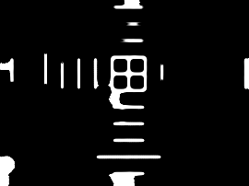
C.1.2 (DRLSE)
timestep = 5, iter_outer = 60, lambda = 5, alfa = 2.2, epsilon = 1.0, sigma = 1.2

Slide 38




C.1.2 (Gradient Vector Flow)
Snake curve x(s) = [x(s),y(s)]
Energy function:
Snake curve that minimizes E should satisfy:
where
GVF field v(x,y) = (u(x,y),v(x,y)) minimizing the energy function

Slide 39
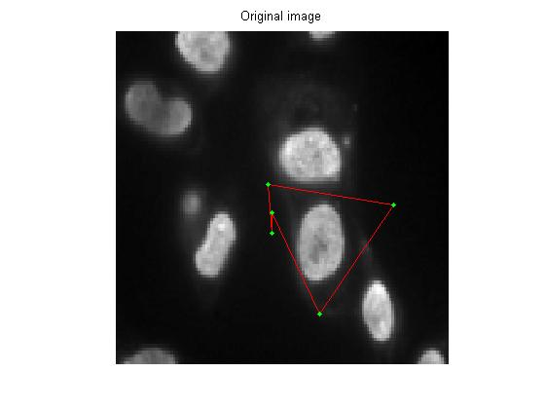
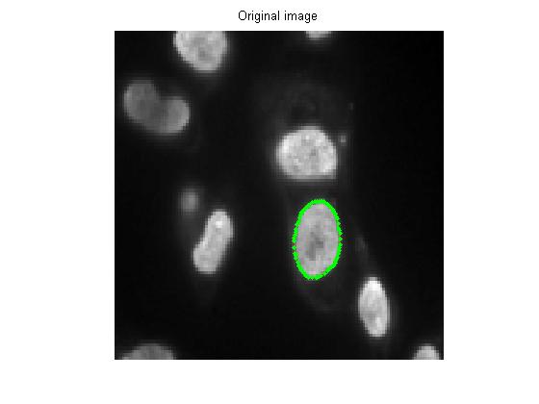
C.1.2 (Gradient Vector Flow)
Mu = 0.2, Alpha = 0.5 beta = 0, gamma = 1, kappa = 1

Slide 40
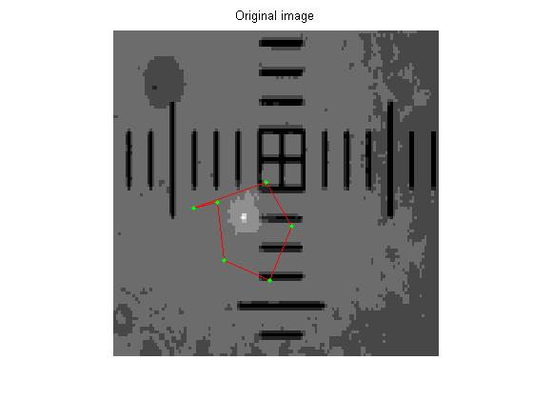
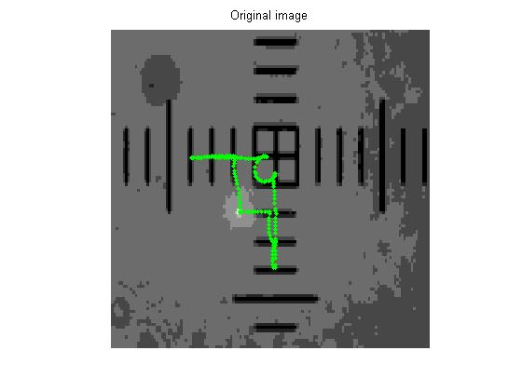
C.1.2 (Gradient Vector Flow)
mu = 0.2, alpha = 0.2, beta = 1, gamma = 1, kappa = 0.8

